Slide 1
Writing Effective Emails

Slide 2
Introduction
The ability to communicate effectively in the workplace is essential. This resource will introduce you to the fundamentals of email writing skills.

Slide 3
Introduction to email
Email is an important business communication tool. Email allows you to communicate with people and transfer files from one place to another rapidly. You can communicate with people from all over the world with the press of the Send button.
Despite how easy it is to access and use email, there are some important points you should be aware of when using it. The following sections will take you through email procedures and protocols.

Slide 4
Writing Email
Email basics
    ··Know your audience
    ··When to use email
    ··Email security and the workplace
    ··Tips for effective emails
Structure of emails
    ··The beginning
    ··The subject line
Language focus
    ··Editing emails
    ··Using tone effectively

Slide 5
Writing tips
Clear, concise and polite writing is important for successful communications in the workplace. The fundamental writing tips covered are:
    Short and simple sentences
    Clear concise language
    Avoiding unnecessary repetition
    Strong verbs
    Using bullet points

Slide 6
Writing Email

Slide 7
Email basics
Knowing your audience
Every time you write something you should have a particular reader or audience in mind. You must adapt the content, tone and language of your email to the situation (context) and intended audience of your communication. This does not only apply to email, but to all communication.

Slide 8
Email basics
When composing your email, do not assume that the receiver will understand your language. You should always:
  focus your writing to assist your readers
  make sure you know who your reader is before you start to write - the way you would write something to a friend or colleague would be different from the way you would write to a supervisor
  take care when using acronyms e.g. asap, technical language and even humour.

Slide 9
Email basics
Appropriateness is the key to knowing your audience, appropriateness of language, content and tone.

Slide 10
When to use email
Even though email is quick and easy to use, sometimes another form of communication might be more suitable. Think about your message and the purpose it is meant to achieve. If a phone call would be better, don't use email. It would be better to think of an alternative to email when:
  your message is personal or confidential
  the news you have to give is bad. It is easy to sound unconcerned when you deliver unpleasant news by email

Slide 11
When to use email
  you are worried that your message might not be clearly understood
  you need an immediate response
Language barriers and time difficulties may also be factors to consider.
  Scenarios
Use the checklist to think about whether it would be appropriate to use email in the following situations.

Slide 12
When to use email cont.
Description (Yes /No)‏
  You need to confirm travel arrangements for a work conference to Hong Kong
  Your friend's mother has sadly passed away.
  You need to remind your colleagues of a forthcoming meeting.
  You need to inform an employee that their services are no longer needed

Slide 13
Security
There are many issues regarding computer security and email security. There are the issues of personal security, company liability and viruses to name a few. This section will give you an overview of security issues and email.
  Personal use & security
  Workplace email & security
  Viruses

Slide 14
Personal use & security
Email is a quick way to send information but it is not secure. If you would not be happy to have anyone else read your message or view an attachment, it would be better not to send it by email!
In the workplace, the email system is meant for business use, but most companies allow for some private use of email. However, you need to be aware of your company's email policy.

Slide 15
Workplace email policy & security
There have been legal cases regarding the use of email where a company has been found guilty of libel over email content. Email is a business tool and users are expected to use it in a responsible, effective and lawful manner.
You are not allowed to send emails that offend another person. You need to be aware of the legal risks of email. These are:

Slide 16
Legal risks
  if you send emails with any libelous, defamatory, offensive, racist or obscene remarks, you and your company can be held liable
  if you forward emails with libelous, defamatory, offensive, racist or obscene remarks, you and your company can be held liable
  if you unlawfully forward confidential information, you and your company can be held liable

Slide 17
Legal risks
  if you unlawfully forward or copy messages without permission, you and your company can be held liable for copyright infringement
  if you send an attachment that has a virus, you and your company can be held liable.

Slide 18
Legal requirements
There are laws governing the use of email based on the legal risks:
  It is strictly forbidden to send or forward emails that contain libelous, defamatory, offensive, racist or obscene remarks. If you receive an email like this, or are the subject of an email like this, you must immediately notify your supervisor.
  You must have permission from the sender to forward an email to another person .

Slide 19
Legal requirements
  Do not forge or attempt to forge email messages.
  Do not disguise or attempt to hide your identity when sending email.
  Do not send email messages from someone else's account
  Do not copy a message or an attachment belonging to another person without the permission of the originator.

Slide 20
Viruses
Most viruses are transmitted through email. There are some precautions you can take to minimize the risk of viruses. These apply to both private use and business use of email.
  Do not open any attachment that you are unsure about or if you do not know the sender!
  If your email program has a preview pane, use it to preview your message before opening.

Slide 21
Viruses
  Run a virus check on any attachment before you open it.
  Many companies have anti-virus software on their servers to filter out viruses. This is one preventative measure, but you should still virus check any attachment.

Slide 22
(I) Email basics-10 tips for effective emails
Think before you write. Plan your message.
Use the subject line to capture your reader's attention.
Keep your message short and clear. Remember that the screen shows only about half of what you see on hard copy.
If your message is long, give a summary at the start.
You are accountable for what you write. Always write your message as if your boss were going to read it.

Slide 23
(I) Email basics-10 tips for effective emails
Do not send angry messages. Take a few minutes to cool down before you start your email.
Don't type your message in capitals. Capitals are considered to be SHOUTING and are rude.
Respect common grammar & spelling conventions. Don't type your entire message in lower case, and run a spell / grammar check over the message.

Slide 24
(I) Email basics-10 tips for effective emails
Send messages only to people who need to read them. Respect other people's time and don't forward junk email to them. Use CC: and BCC: sparingly.
Proofread your message before sending it. You should always reread your message before you send it and correct any mistakes.

Slide 25
Structure of an email

Slide 26
Structure of emails
An email is a form of communication. As such it has a specific structure that should be used. Since reading from a screen is more difficult than reading from paper, the structure and layout of messages is very important. Use short paragraphs and leave blank lines between them. When you have more than one point to make in your email, put the most important information first, working down to the least important.

Slide 27
Format of Email Writing
The email writing format is likewise for each of the categories. Though the selection of words and language varies depending upon the kind of email. One can employ friendly and casual writing in informal emails. The language utilized in formal emails should be professional, precise, and formal.
The Important steps for writing the email are:
Subject Line
Salutation
Body of the mail
Signature

Slide 28
Email Writing Format Samples
The format is given here
From: Sender’s Mail id
To: Recipient’s Mail id
Cc: Other concerned person’s with visible email ids
Bcc: Other concerned person’s with invisible email ids
Subject: Reason for writing the mail
Greeting/Salutation: Display your respect (Such as Sir, Respected Sir)
Main Body: Content of the email
Introduction
Discuss the matter in detail
Conclusion
Closing line: Thank you for the consideration
Attachments: Attach reference files
Signature line: Name and contact details

Slide 29
(II) Structure of emails- The beginning
A successful email has a good first paragraph. Why?
  It tells the reader why you have written the email so they can decide whether to keep reading.
  It is concise and to the point.
  It gives the most important information first.
  If it is a long email, it should give an overview of the entire message, so it holds the reader's attention.

Slide 30
Example
Read through the following email and decide if the beginning is successful.
Check List
  Does this tell you why the sender has written the email so you can decide whether to keep reading?
  Is it concise and to the point?
  Does it give the most important information first

Slide 31
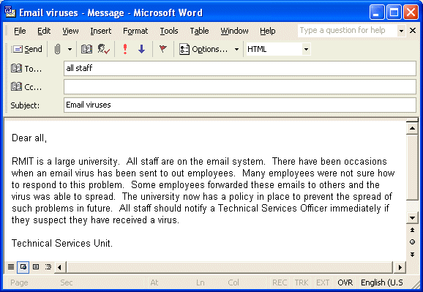
Check list

Slide 32
Analysis the Example
The previous email has problems with the beginning. They are:
  too much unnecessary information
  the important information comes at the end.

Slide 33
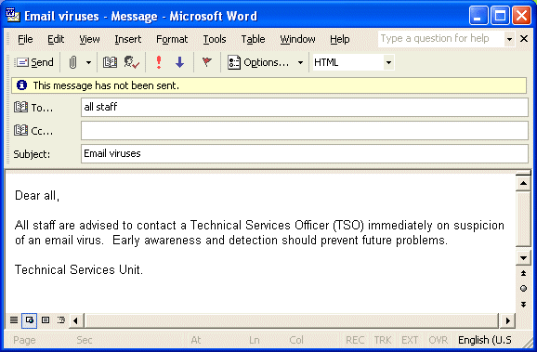
Compare this to: Why is this better?

Slide 34
Compare this to: Why is this better?
It tells the reader the purpose of the email in the first sentence.
There is no unnecessary information.
It is short, concise and to the point.

Slide 35
Activity1
Rewrite the beginning of the following email. Remember to:
  put the most important information first
  take away any unnecessary information

Slide 36
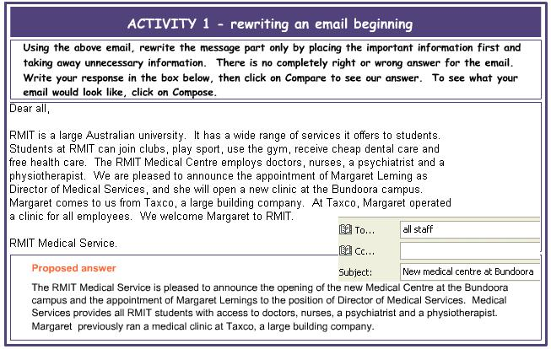
Activity1

Slide 37
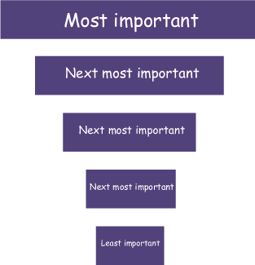
(II) Structure of emails- Email model
As emails are short pieces of communication, there is a set structure you should use.
  Email model
  Why use this approach?
    People are busy and do not have enough time to read everything.
    The reader will look at the beginning and decide whether to read on.
    It helps keep the email short and to the point.

Slide 38
Activity 2
Read through the following sentences and drag them into order from most important to least important.
Notice that the sentences are short and to the point. There is no irrelevant information in them.

Slide 39
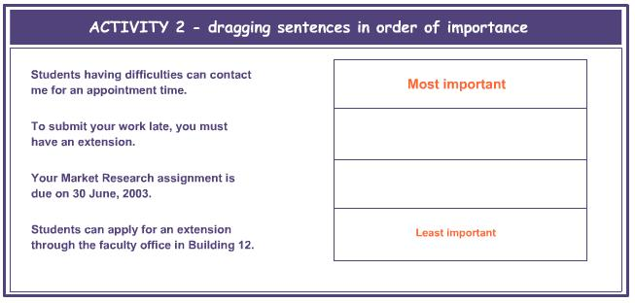
Activity2

Slide 40
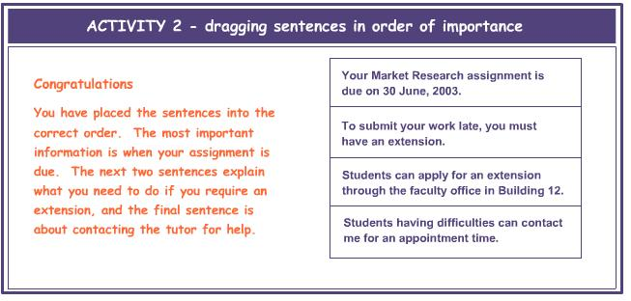
Activity 2 - solution

Slide 41
Getting started - 3 steps to writing easy emails
Use the following model as a way to write good emails. Imagine you start the email with 'I am writing to tell you...'. This will automatically make you write the most important information next. Write your email, then go through it and take out any unnecessary words, including the beginning, 'I am writing to tell you'.
Begin with 'I am writing to tell you...'
Add your most important information.
Edit - take out any unnecessary words.

Slide 42
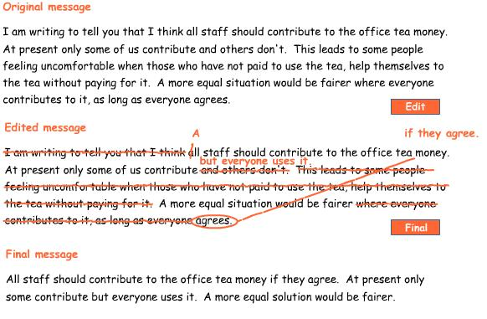
Getting started - 3 steps to writing easy emails - Example

Slide 43
(II) Structure of emails- Subject lines
When you send an email you want to make sure that it is opened, read and acted upon. The subject line of each email message needs to say precisely what the email is about.
A good subject line should give the recipient an accurate idea of what the message is about before it is opened. The subject line is often the only clue the recipient has when filing messages into folders. If you are replying to a message but are changing the topic, it is a good idea to change the subject line.
In the following exercise read the email example and choose the correct subject line.

Slide 44
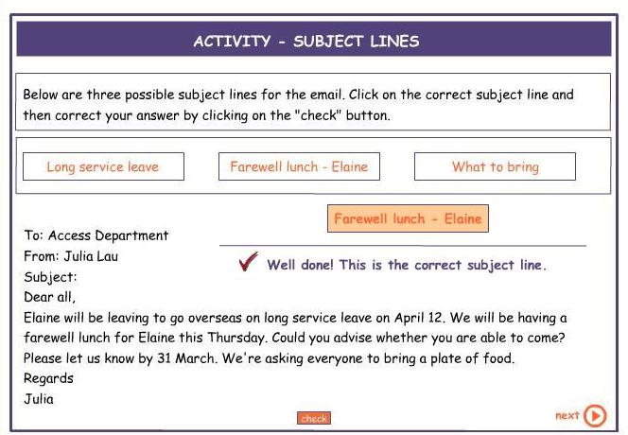
(II) Structure of emails- Subject lines

Slide 45
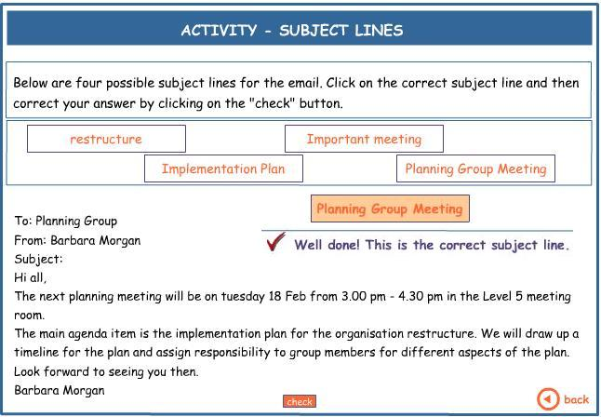
(II) Structure of emails- Subject lines

Slide 46
(II) Structure of emails- Subject lines
Ineffective Subject Lines | Effective Subject Lines
Question | Question About POL 120 Research Paper
Request | Recommendation Letter Request
Project | BIO 275 Group Project Submission
Meet | Study Group Meeting Times
Job | Assistant Network Administrator Inquiry
Plan | Marketing Plan Recommendations

Slide 47
Writing Email (III)
Language focus

Slide 48
(III) Language focus-Start of an email
How to Start a Professional Email
Create a professional email address that uses your first and last name or your initials.
All professional emails need to start with a formal greeting. While “Dear” can be a reasonable starting point, it can feel a bit stiff. Instead, you could use “Good morning,” “Good afternoon,” or “Good evening,” depending on the time when they write. It conveys a proper tone but feels a bit warmer than “Dear.”
Then, you should address the recipient by their proper title (Dr., Mr., Ms., etc.) and either the recipient’s last name or their first AND last name. For example, “Good evening Dr. Doe” or “Good evening Dr. Jane Doe,” are both suitable approaches.

Slide 49
(III) Language focus- Editing your email
When editing your email, you need to think about three things.
  Remove any unnecessary conjunctions (and, but, etc).
  Remove unnecessary words - words that do not add to your main point(s)
  Remove unnecessary punctuation (eg, commas)‏

Slide 50
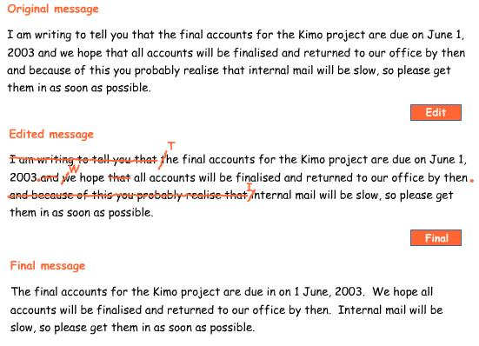
(III) Language focus- Editing your email

Slide 51
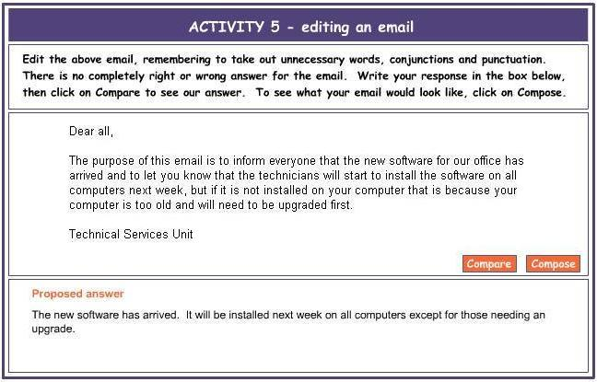
Activity 5 Edit the following email

Slide 52
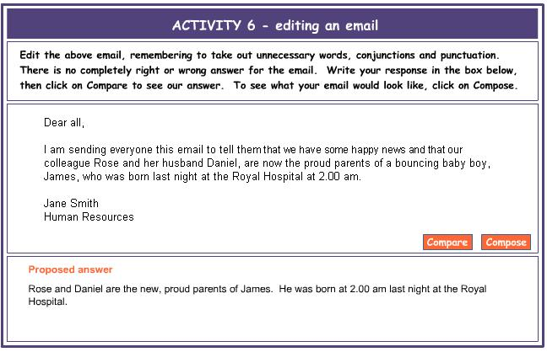
Activity 6 Edit the following email.

Slide 53
(III) Language focus- The right tone in emails
When writing business emails a professional yet conversational tone is the most effective.
Imagine you are attending a function attended by your colleagues and supervisors. In this situation you would need to be polite, positive and friendly. At the same time you need to be professional. Also you need to consider who you are speaking to and their position and level in the organisation.

Slide 54
(III) Language focus- The right tone in emails
Email communication is similar but with an important exception:
  your communication is electronically transmitted so it can be passed on to anyone within or external to the organization.
      Make it polite & positive
      Making requests

Slide 55
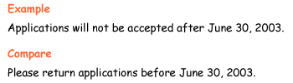
Make it polite & positive
Everyone responds to a polite positive tone. Criticism, rudeness or negativity will lead to reader resistance. Email messages need to show politeness and should be positive whenever possible, otherwise they risk sounding abrupt and possibly angry.

Slide 56
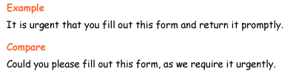
Making requests
When making requests, it’s a good idea to use a modal or conditional construction such as 'Could you …' or 'Would you be able to...'

Slide 57
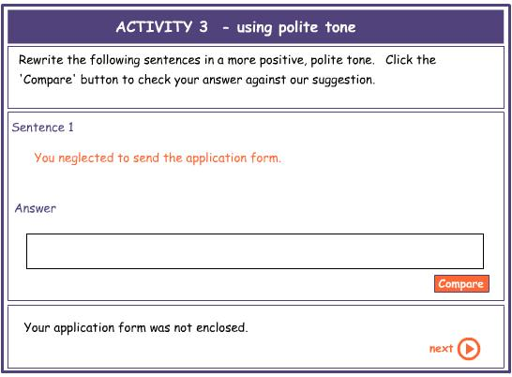
Activity 3 Rewrite the following sentences in a more positive and polite tone.

Slide 58
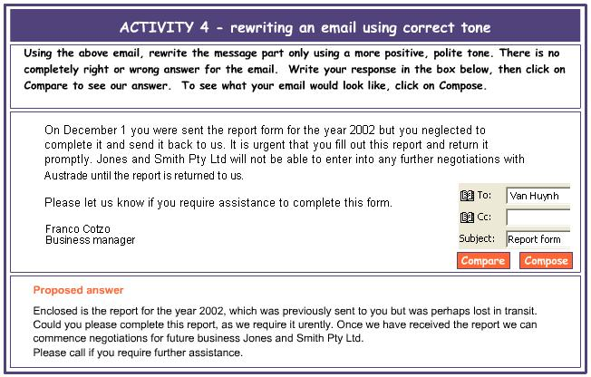
Activity 4 Rewrite the following email in a more polite tone.

Slide 59
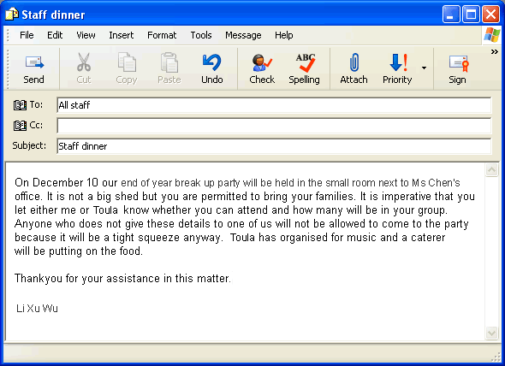
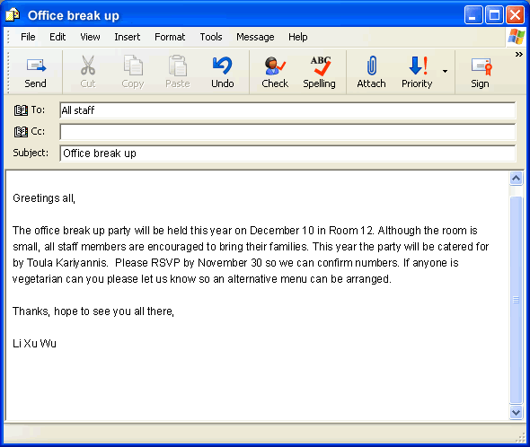
Comparing tone Which of the two emails below would you prefer to receive?
1
2

Slide 60
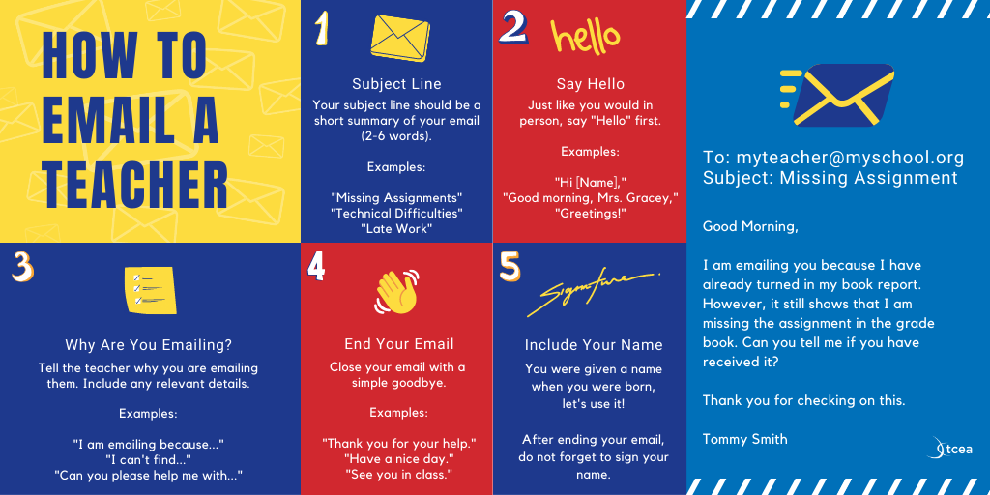

Slide 61
END
I.Samar taher
I.Taghreed Bagies
Yasir Saleem

